Slide 1

A New Model for Higher Education and Research Delivery
Upper Spencer Gulf

Slide 2
Upper Spencer Gulf Common Purpose Group
Upper Spencer Gulf Common Purpose Group Inc, trading as “Spencer Gulf Cities”
An alliance between Pt Augusta, Port Pirie, Whyalla Councils
20 year history – Group formed 1998 by the three cities to improve economic and social situation and provide a united voice.
Membership is 3 x Mayors plus Council CEO’s (ex-officio)
Committees to support key focus areas: Education; Planning Reform; Procurement; Conferences/Events; USG Mayors & MPs

Slide 3
Upper Spencer Gulf - Future Industries
Region is currently transitioning from traditional heavy industry base.
Opportunity to build on comparative strengths and diversify economy:
Renewable Energy – solar PV and CST, hydro, tidal, wind, storage
Arid Agriculture and Innovation – Sundrop, Betatene, Muradel, Sterile Insect Facility
Mining and Minerals Processing – Nyrstar, Oz Minerals, Arrium
Defence – Cultana expansion
Intermodal Transport and Logistics – port/rail/air/road
Event and Nature Based Tourism – conferences, marine tourism
Regional Service Centres – govt services, health, aged care, education, retail
= critical to improve higher education, skills and research capabilities in our region to support these emerging sectors.

Slide 4
“... education is the future foundation of economic and community growth, innovation and entrepreneurship in the Upper Spencer Gulf …”
“… a clear need to improve skills capacity in the region in order to realise a strong and prosperous economy..”
“... the lack of scientific and technical capability in the region is a key barrier to future growth and economic diversification ..”
O’Neil M (2012) The Common Purpose – Advancing the Economic and Social Development of the Upper Spencer Gulf; A report prepared by the South Australian Centre for Economic Studies for the Upper Spencer Gulf Common Purpose Group
KPMG (2012) Upper Spencer Gulf Heavy Industry Hub.
Houghton K (2014) Upper Spencer Gulf Stocks and Flows - Residents, Employment and Socio-Economic Connections across the Upper Spencer Gulf, report prepared by , Strategic Economic Solutions for Upper Spencer Gulf Common Purpose Group

Slide 5
Key Education and Workforce Issues
Lack of technical, professional and scientific capacity within the USG.
Fly-in, Fly-out research and expertise – no local or lasting capacity generated.
Significant economic transition – retraining existing workforce.
Upskilling – lack of locally available VET-uni pathways, postgrad, accreditations.
Unemployment, underemployment - particularly youth, increase in 457 visas.
Over 2500 enrolments in USG annually (SATAC). Online completion rates <20% vs >80% for online + face to face student and tutorial support.
Educational disparity:
Urban degree holders = 31% vs Regional degree holders = 15%
Above certificate level qualification = SA average of 23% vs 11% for USG.
Lack of critical population mass in the USG to sustain traditional university – a new model required.
Proposed Higher Education Reforms – ‘study hubs’, ‘regional scholarships’

Slide 6
Upper Spencer Gulf – Tailored Model
Concept largely based on Geraldton/Cooma COTECs but tailored to Upper Spencer Gulf:
Includes undergraduate, postgraduate, VET and research support
No duplication of existing local courses
Co-location with existing facilities
Tailored to smaller population and tri-city geography
A presence in each of the three cities – commence in Port Pirie, then Port Augusta
Opportunity for specialisations across the three cities
Better local coordination of university interest in the USG
Leverage existing industry engagement (ie Industry Leaders Groups, industry clusters)
Service local demand for post-graduate qualifications and professional up-skilling

Slide 7
Proposed Outcomes
Build lasting research/technical capacity in the region
Local decision making - what is delivered, how, when, by whom and quality
Expand higher education and research offerings delivered in the region
Additional 2-5% new students engaged in higher education in the USG
Stronger industry/community/provider partnerships
More efficient use of resources and avoiding duplication of effort
Establish a collaborative physical presence within broader educational precinct
Higher education and research as an industry as well as an enabler

Slide 8
Responsibility of USG COTEC
Local tutorial support (local tutors drawn from industry)
Local school engagement, recruitment, enrolment, student pastoral care
Local facilities - study spaces, tutorial rooms, NBN broadband and IT support, computing facilities, student amenities
Local coordination and input into tailored training and short courses with industry and academic partners
Local support for Higher Degree Research students - including study support, tutor access and industry-embedded placement
Local support for researcher exchanges and specialist visiting researchers
Coordination of local industry scholarships
Facilitating local access to demonstration and pilot research sites
Facilitate research partnerships between industry and research proponents
Local connection to regional and Government agencies

Slide 9
Responsibility of Education Provider
Course content and quality as contracted
Delivery of undergraduate and postgraduate courses
Award of qualifications
Online development and teaching
Supervision of Higher Degree Research and pHD students
Provision of required software and systems access for students and local COTEC staff

Slide 10
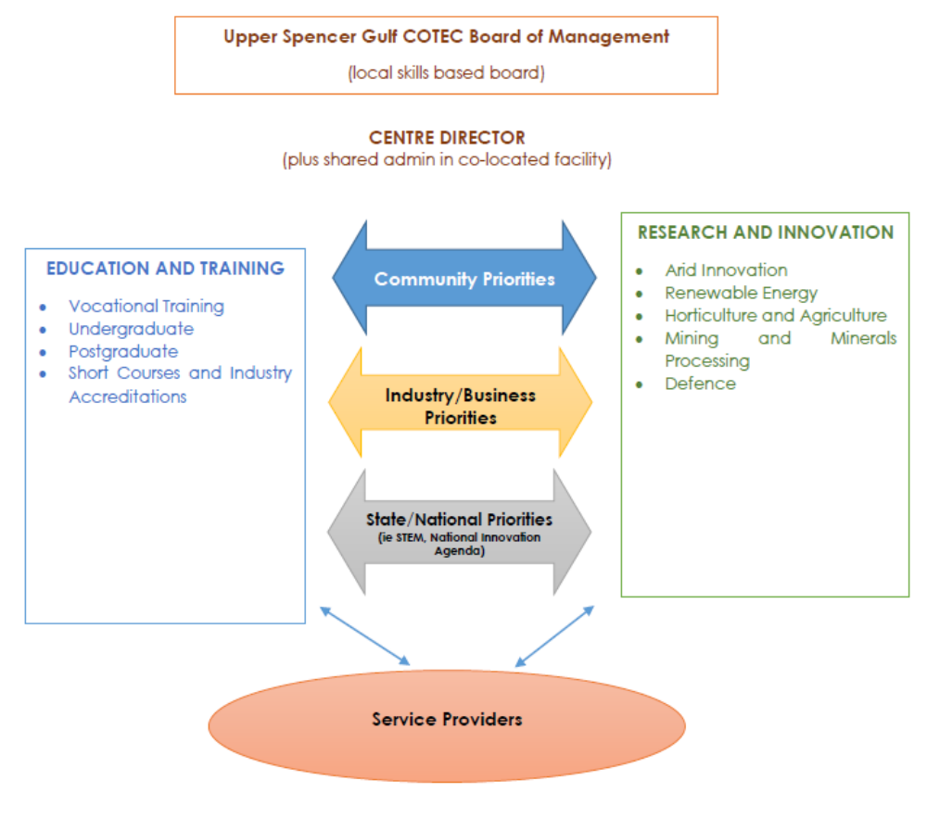
What might our model look like?

